Slide 1

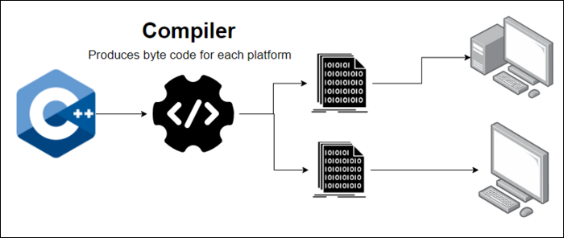
Just-In-Time (JIT) Compilation
Presented By : Manikanta K (192211340)
Karthik M (192211383)

Slide 2

Just-In-Time (JIT) Compilation
This presentation delves into the world of Just-In-Time compilation, exploring its concepts, benefits, challenges, and real-world applications. We'll cover the workings of JIT compilation and compare it with traditional interpreters and compilers. We'll then explore its optimization capabilities and highlight its impact on modern software.

Slide 3
What is JIT Compilation?
Dynamic Compilation
Key Players
JIT compilation is a technique where code is translated to machine code at runtime, just before execution. This allows for optimization based on the specific runtime environment and data.
The process involves a JIT compiler, responsible for translating bytecode into machine code. It dynamically analyzes the program and adapts its optimization strategies.

Slide 4
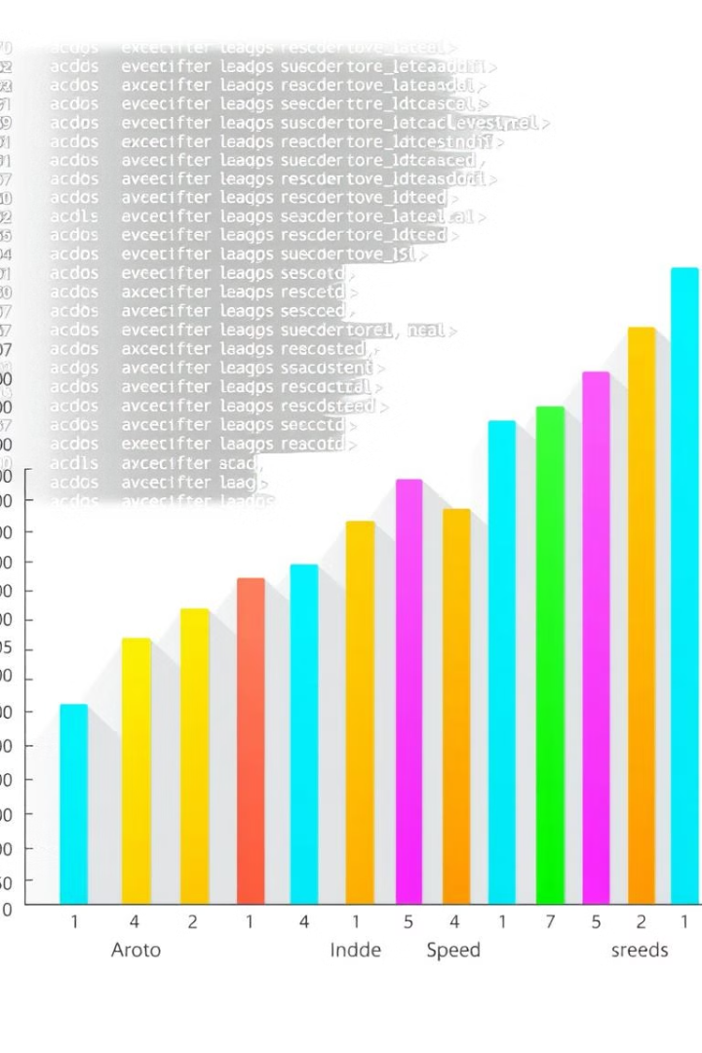
Benefits of JIT Compilation
1
Performance Boost
2
Cross-Platform Compatibility
JIT compilation often leads to significant performance improvements, as it optimizes code for the target machine and specific runtime conditions.
JIT compilation allows programs to be written once and run on various platforms, as the translation to native code happens at runtime.
3
Dynamic Optimization
JIT compilers can adapt their optimization strategies based on runtime data and code behavior, resulting in better performance over time.

Slide 5
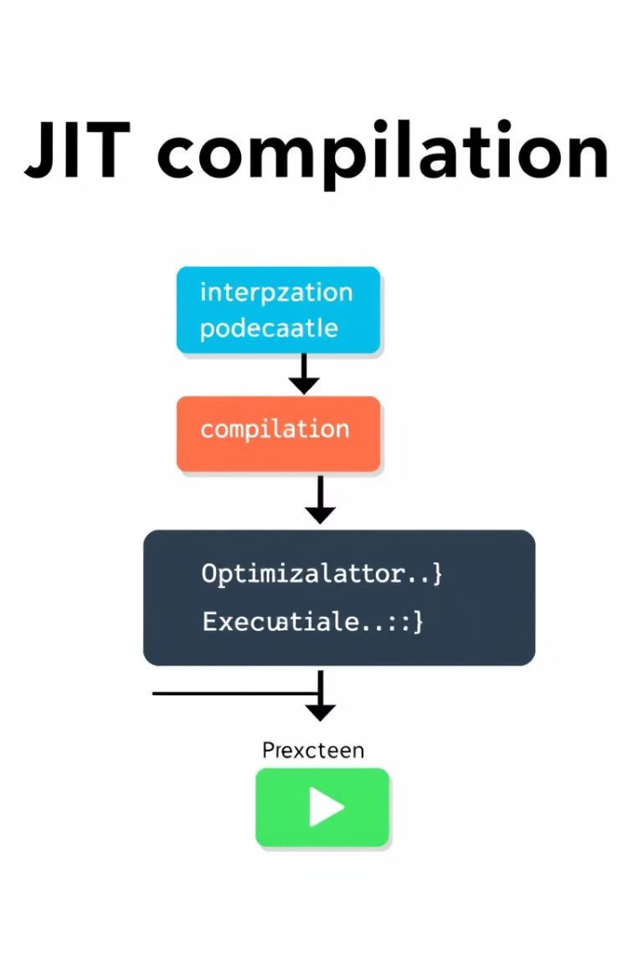
How JIT Compilation Works
1
The program is written in a high-level language (e.g., Java, Python, JavaScript).
2
The source code is compiled into an intermediate representation (e.g., bytecode) using an interpreter or a compiler.
3
At runtime, the JIT compiler analyzes the intermediate representation and translates frequently executed sections into native machine code.
4
The optimized machine code is cached for future execution, ensuring faster performance for frequently used sections.

Slide 6
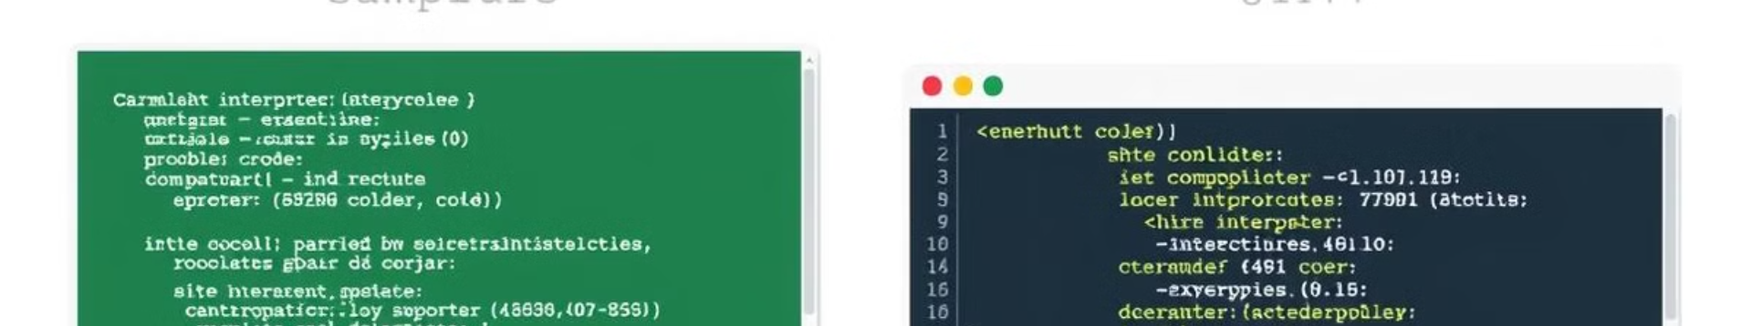


Interpreters vs. JIT Compilers
Interpreters
JIT Compilers
Interpreters directly execute the source code line by line, without a compilation step. They are simpler and more portable but generally slower.
JIT compilers combine the benefits of interpretation (dynamic execution) and compilation (optimized performance), offering a balance between speed and flexibility.

Slide 7

Challenges of JIT Compilation
Start-Up Overhead
Complexity
JIT compilation can add a slight initial delay, as it requires time to analyze and translate the code.
Implementing and optimizing JIT compilers can be complex, requiring expertise in compiler design and runtime optimization.
Memory Consumption
JIT compilation may lead to increased memory usage, as the compiler stores both the original code and the optimized machine code.

Slide 8



Performance Optimization with JIT
Method Inlining
1
Replaces function calls with the function's code directly, reducing overhead.
Loop Optimization
2
Improves the performance of loops by unrolling or optimizing their iterations.
Adaptive Optimization
3
Dynamically analyzes code execution patterns and optimizes based on runtime data.

Slide 9




Real-World Examples of JIT Compilation
Java
JavaScript
Python
The Java Virtual Machine (JVM) uses JIT compilation to improve performance and ensure platform-independent execution.
Modern JavaScript engines, such as V8 (Chrome) and SpiderMonkey (Firefox), employ JIT compilation for speed and efficiency.
The Python interpreter, CPython, uses a combination of bytecode compilation and JIT optimization for enhanced performance.

Slide 10

Conclusion and Future Trends
1
2
Efficiency
Evolution
JIT compilation has revolutionized software development, enhancing performance and enabling cross-platform compatibility.
Future advancements in JIT compilation will focus on further optimization, reducing start-up overhead, and enhancing security.

